Slide 1


DealOye: An online platform for buying and selling study materials using web development technologies
Guided By: Presented By:
Prof. Shahida Khan Pavendra Singh Rajput(0827IT211081)
Sanjna Yadav (0827IT211104)
Soni Rathore (0827IT211112)
Vidhi Goyal (0827IT211128)
Vikas Agrawal (0827IT21130)

Slide 2
Contents
Use Case Diagram
Class Diagram
ER Diagram
Activity Diagram
Data Flow Diagram

Slide 3
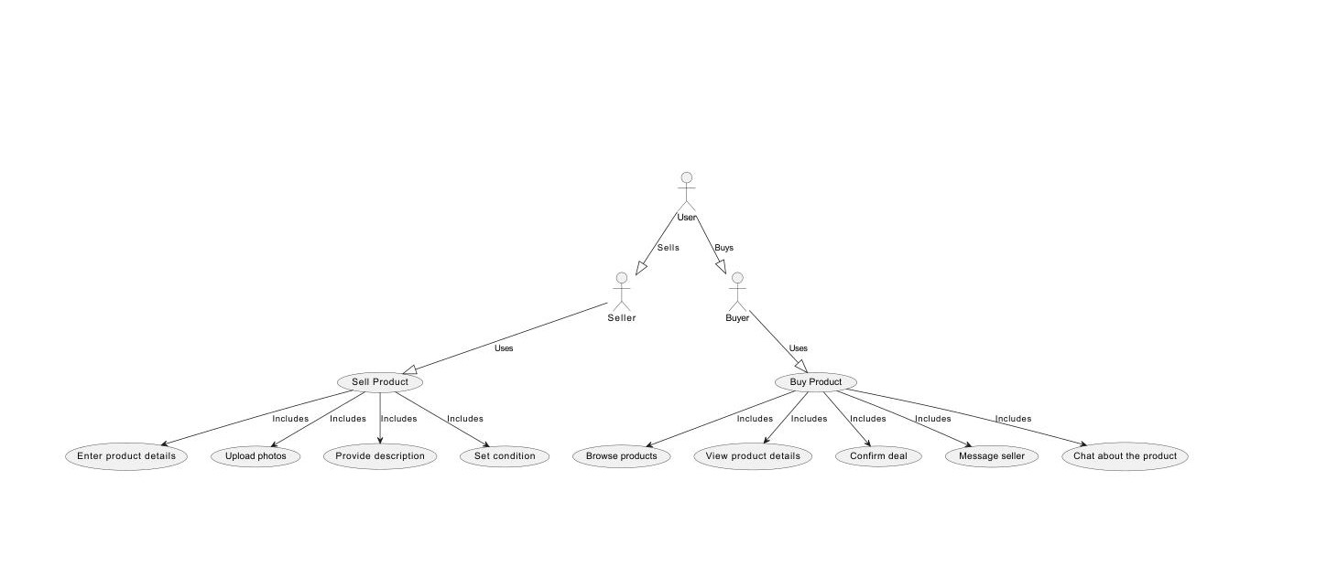
1. Use Case Diagram

Slide 4
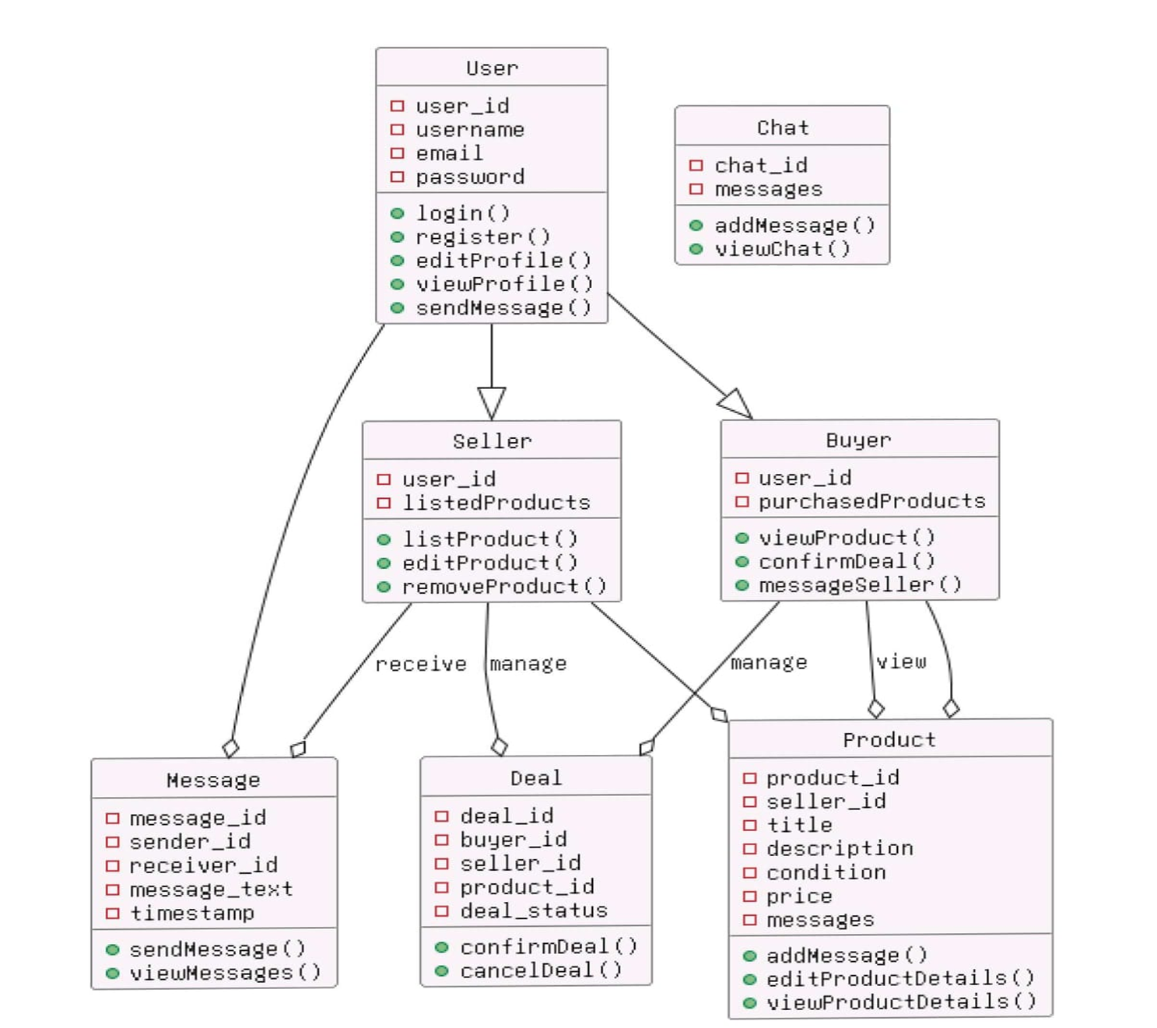
2. Class Diagram

Slide 5
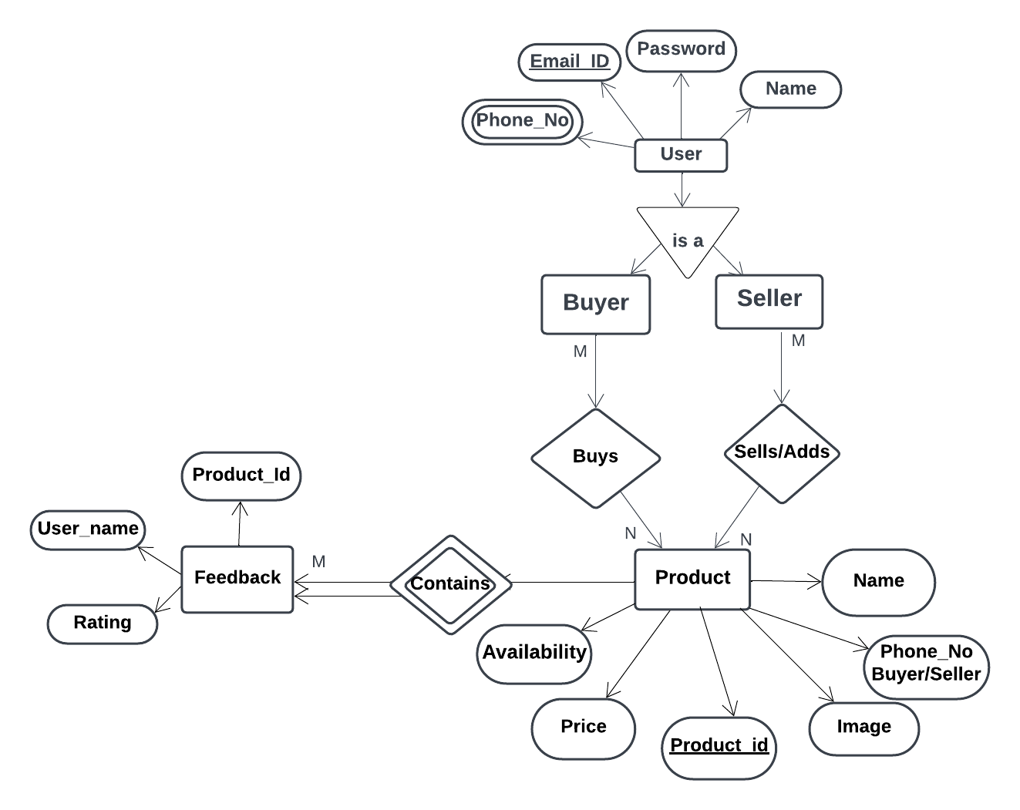
3. ER Diagram

Slide 6
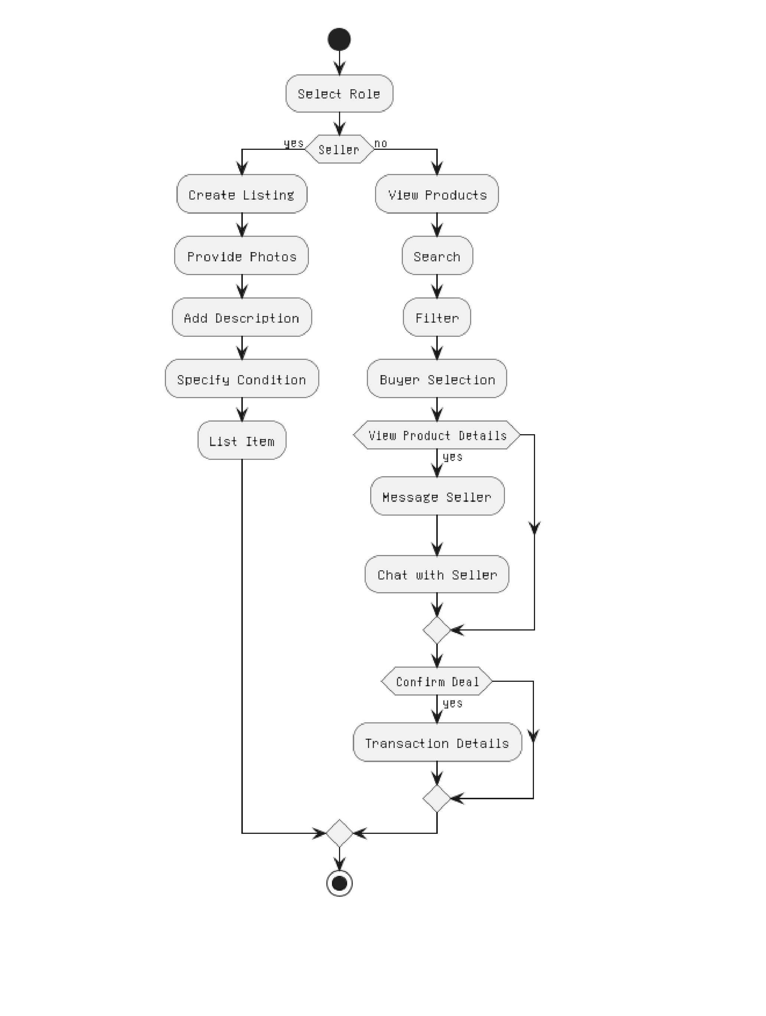
4. Activity Diagram

Slide 7
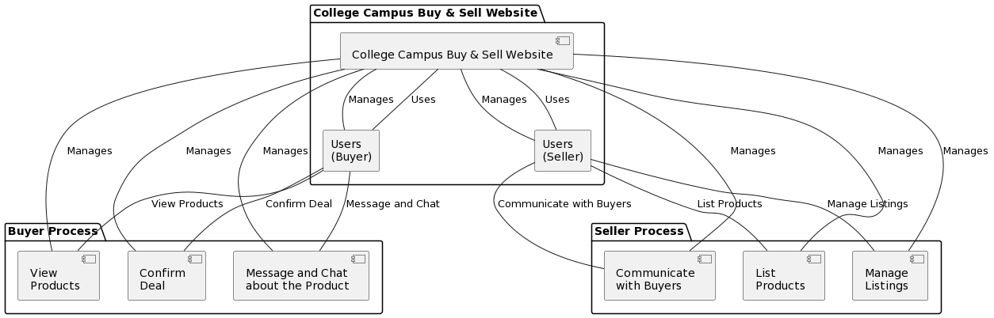
. Data flow Diagram

